Slide 1
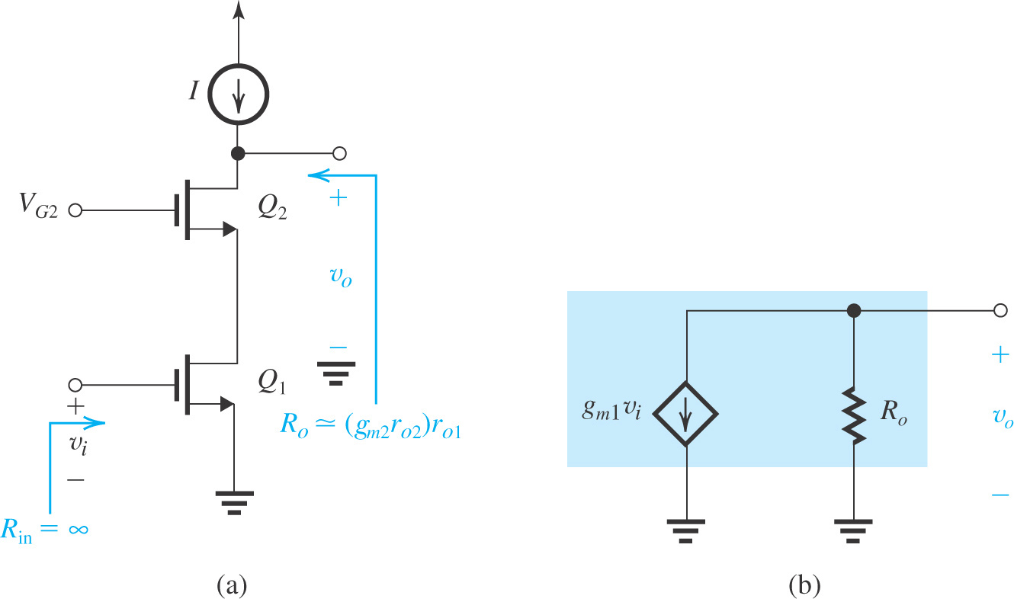

The MOS Cascode:
Voltage Gain
If Q₂ is loaded with an ideal constant-current source as shown in Fig (a), the voltage gain realized can be found from the equivalent circuit in Fig (b) as A_{vo} = v_{o}/v_{i} = –g_{m1}R_{o}.
Thus cascoding results in increasing the gain magnitude from A₀ to A₀²
Figure: (a) A MOS cascode amplifier with an ideal current-source load; (b) equivalent circuit representation of the cascode output.

Slide 2
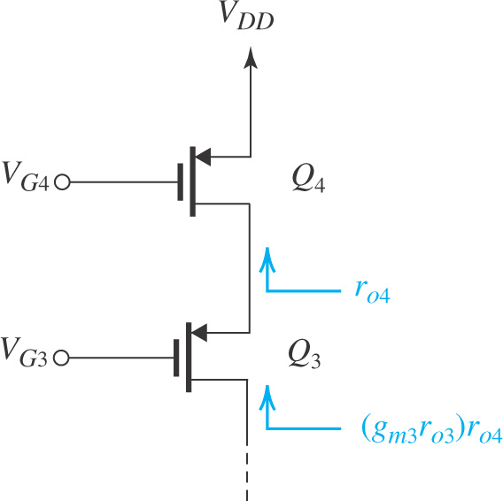
The MOS Cascode:
Cascoding may be employed to raise the output resistance of the current-source load as shown in Figure.
Here, Q₄ is the current-source transistor and Q₃ is the CG cascode transistor.
Voltage V_{G3} and V_{G4} are the dc bias voltages.
The cascode transistor (Q₃) multiplies the output resistance of Q₄, r_{o4} by (g_{m3}r_{o3}) to provide an output resistance for the cascode current source of:
R_{o} = (g_{m3}r_{o3})r_{o4}
Figure: Employing a cascode transistor Q₃ to raise the output resistance of the current source Q₄.
Combining a cascode amplifier with a cascode current source results in the circuit shown in Figure in the next slide.

Slide 3
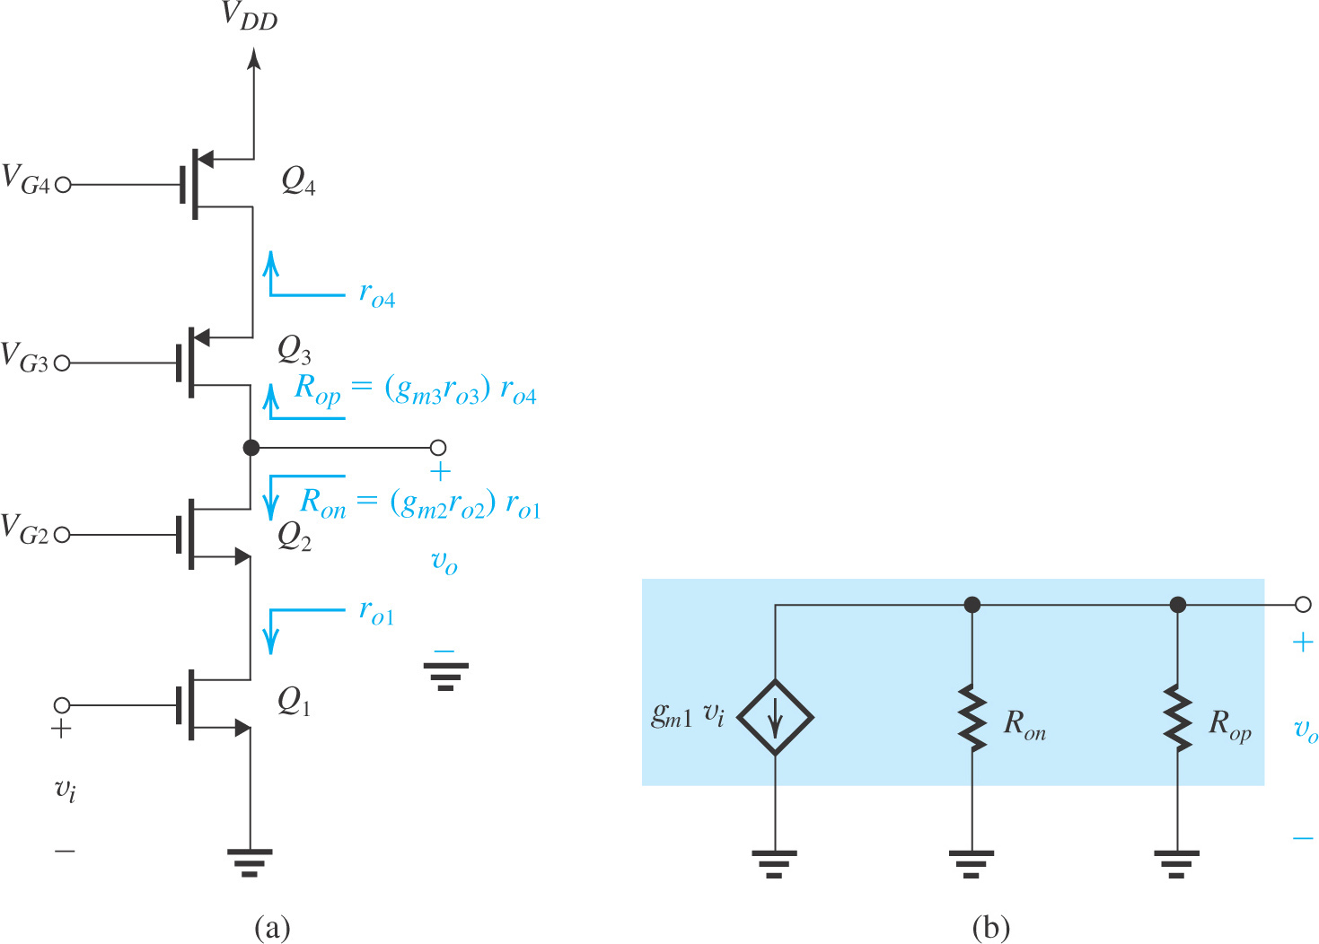
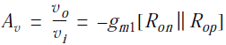
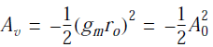
7.3.2. The MOS Cascode
The MOS Cascode:
Voltage gain
For the case in which all transistors are identical
Thus: using the cascode configuration for both the amplifying transistor and the current-source load transistor results in an increase in the magnitude of gain by a factor equal to A₀.
Figure: A cascode amplifier with a cascode current-source load.

Slide 4
Example 2
Figure 7. 10: Employing a cascode transistor Q₃ to raise the output resistance of the current source Q₄.

Slide 5
Example 2 - Solution

Slide 6
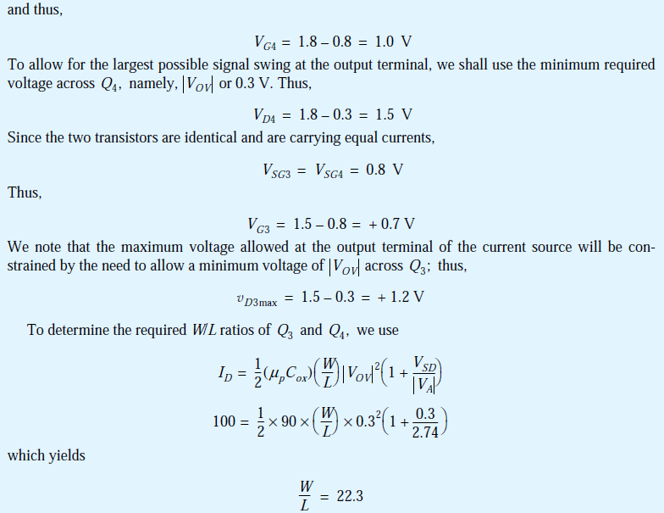

Slide 7
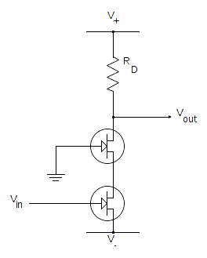
Quiz 2.4
Two NMOS FETs Q1 and Q2 are depicted in the Figure.
If R_{D} is removed and replaced by a current source, the voltage gain v_{out}/v_{in} increases or decreases?
Redraw you proposed circuit to obtain higher voltage gain v_{out}/v_{in}.
Positive voltage
Q2
D
S
Q1
D
S
Negative voltage
You submit your solution not later than March 20, 2020.
You can submit through Blackboard as informed by Mr. Huy on Blackboard announcement.

